Slide 1
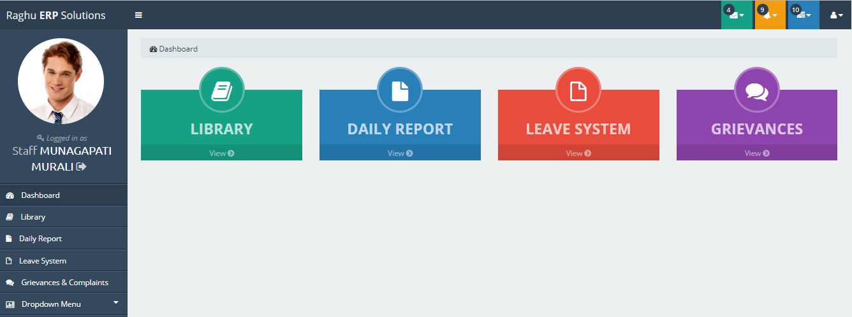
RAGHU ERP solution

Slide 2
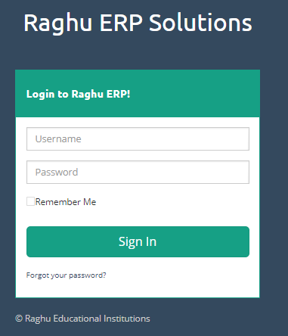
ERP Login Page
Step 1:
URL to login to ERP
http://210.16.79.137/raghuerp/login
Step 2:
Enter user name And password
Step 3:
Click on Sign In button

Slide 3
Home page Menu list
Click on Leave System

Slide 4
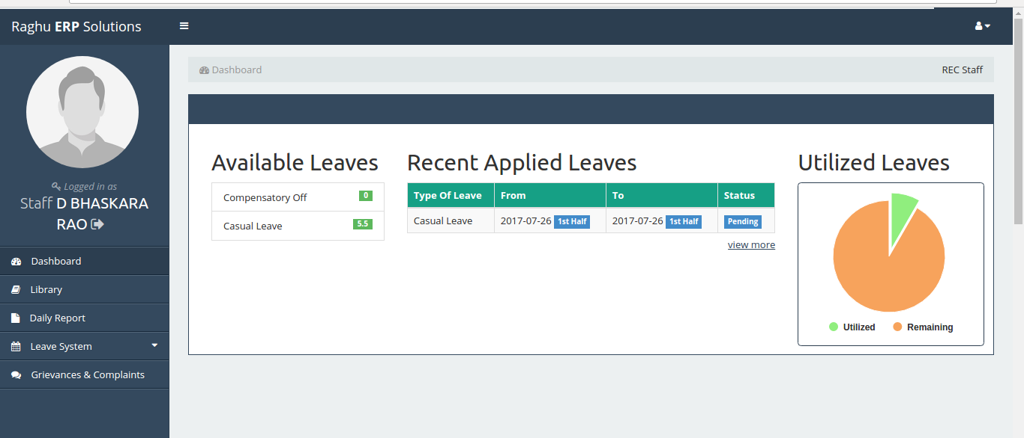
Staff dashboard
Click on view more to see previous leaves history

Slide 5
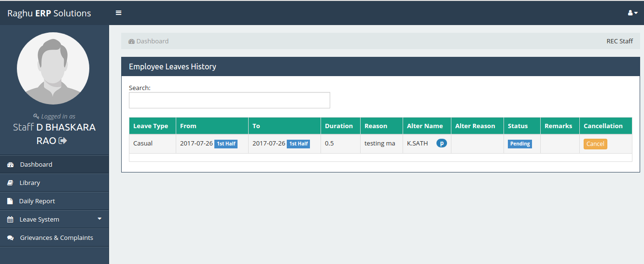
Employee Leaves History Page
Click on cancel button to cancel your leave request

Slide 6
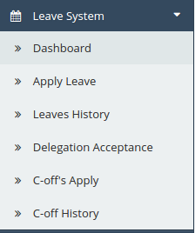
Grievances & Complaints Menu
Click on Leave System
Click on Apply Leave

Slide 7
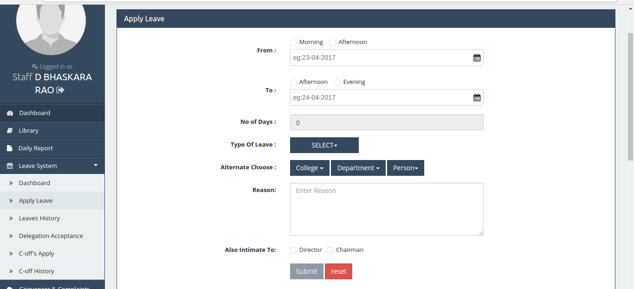
Apply Leave Page
Fill all feilds and click submit to apply leave

Slide 8
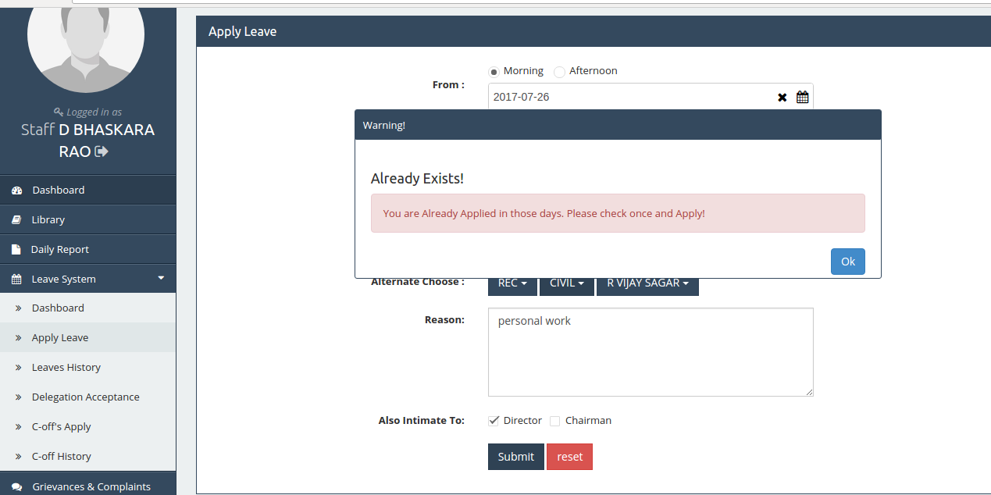
If already leave exists in particular days

Slide 10
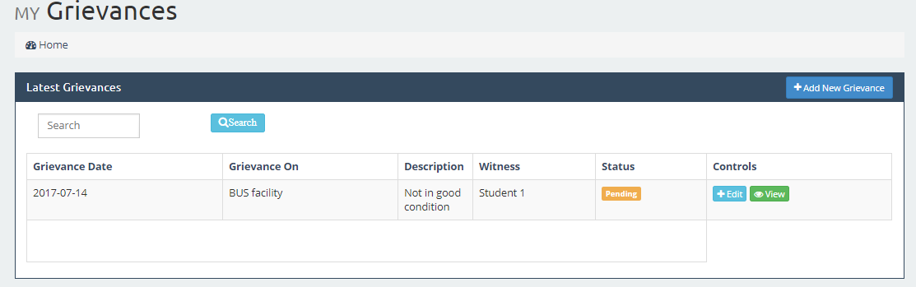
To Add New Grievance
Click on Add New Grievance button

Slide 11
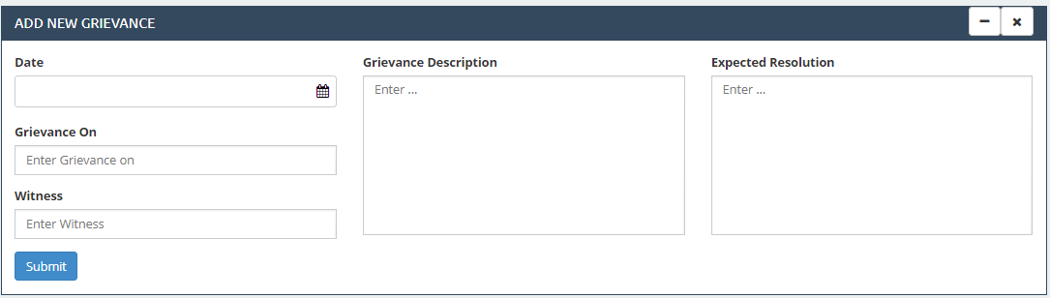
Entertaining New Grievance details
Step 1:
Select Date
Step 2:
Enter Grievance On
Step 3:
Enter Witness
Step 4:
Enter Grievance Description
Step 5:
Enter Expected Resolution
Step 6:
Click on Submit

Slide 12
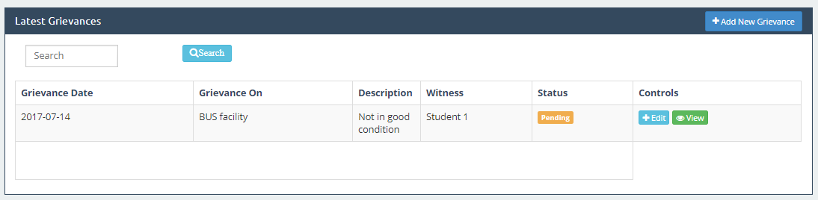
View Latest Grievances
Step 1: After submitting Grievances details will display in below table
Step 2: Click on View button to view the entered details
Step 3: Click on Edit button to change the details

Slide 13
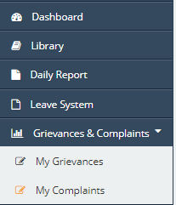
My Complaints
Step 1:
Click on Grievances & Complaints
Step 2:
Click on My Complaints

Slide 14
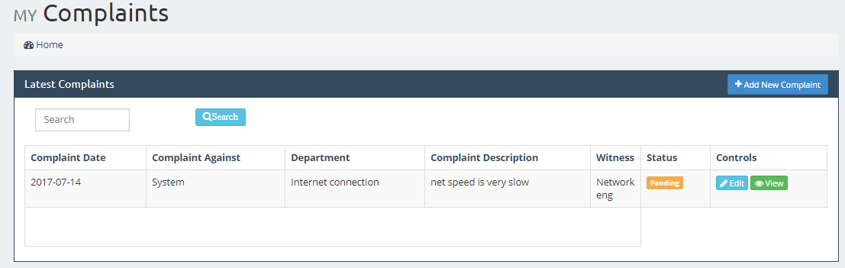
My Complaints
Click on Add New Complaint Button

Slide 15
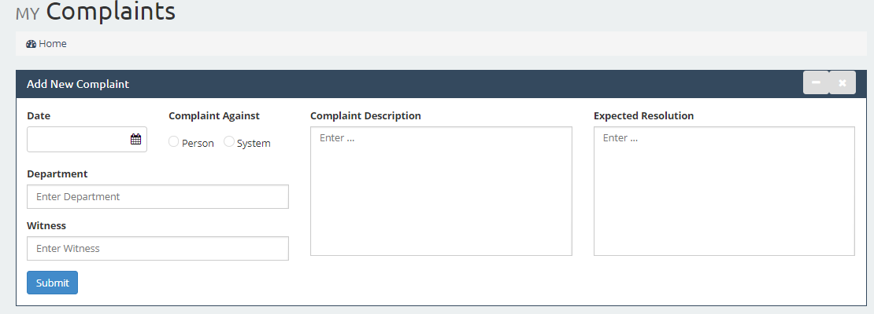
Add New Complaint
Step 1: Select Date
Step 2: Select person or System
Step 3: Enter Department Name
Step 4: Enter Witness Name
Step 5: Enter Complaint Description
Step 6: Enter Expected Resolution
Step 7: Click on Submit Button

Slide 16
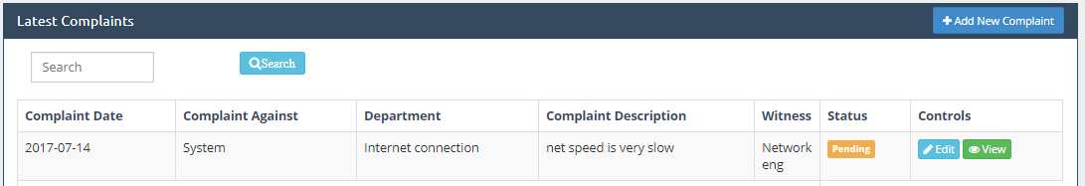
View Latest Complaints
Step 1: After submitting complaint details will display in below table
Step 2: Click on View button to view the entered details
Step 3: Click on Edit button to change the details

Slide 17


